Slide 1
Week.00 SW Jungle Team 7 Presentation
최승현
최혜린
김호집

Slide 2
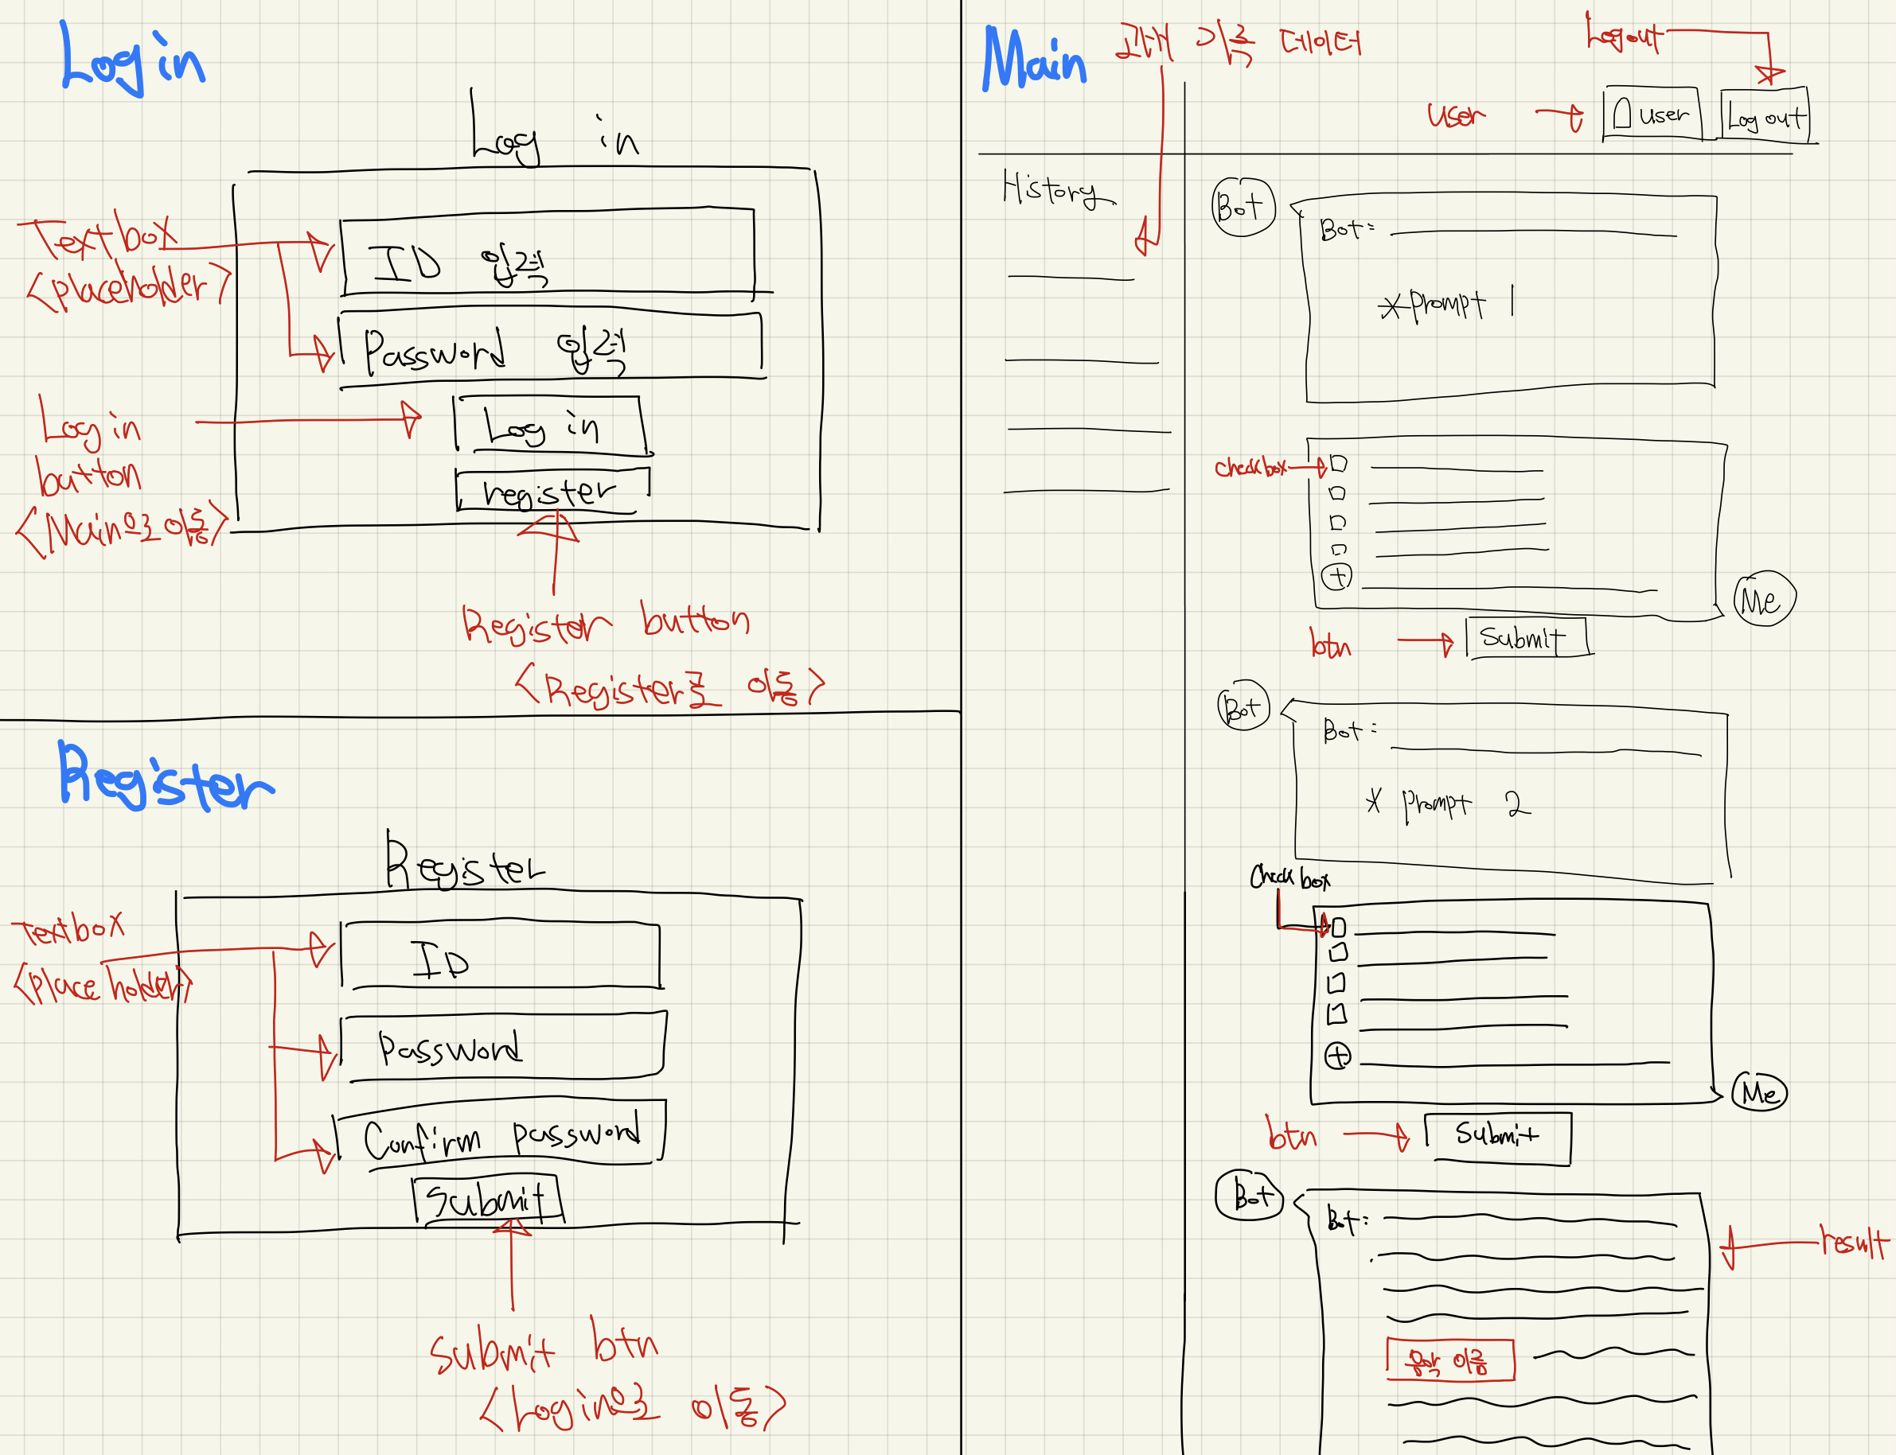
WireFrame (Main Function)

Slide 3
Figma
https://www.figma.com/file/eS8ZOAd7RTTPHIzGj8Pw7V/WEEK00-7%EC%A1%B0?type=design&node-id=0-1&mode=design&t=rDJIFfdAgWu4CYYg-0

Slide 4





Technology stack

Slide 5

Team Collaboration Tool
Utilizing issues of Github
Resolving various conflicts in private branches

Slide 6
Thank you.

